Slide 1
CS 6890 ADL Project Proposal
Team: Eric Larsen
Project Title: Temporal Projection of Grocery Sales

Slide 2

Introduction
Build DNN network to predict future values dependent on past information
Time Series Problems
Projection of information for missing data pools
Business projections

Slide 3
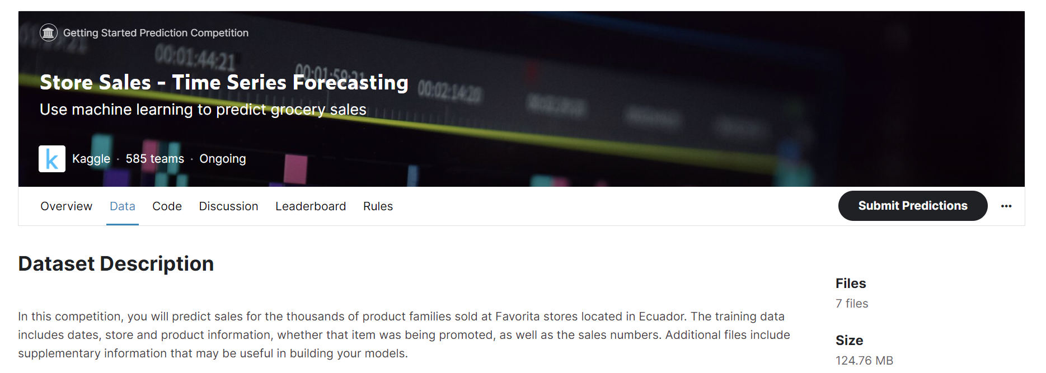
Proposed Project
This Project comes from a Kaggle competition called Store Sales – Time Series Forecasting (https://www.kaggle.com/competitions/store-sales-time-series-forecasting/data)
The Goal:
Accurately predict the unit sales for store items of an Ecuador Grocery Retailer
The Data:
Data is provided by Kaggle and is readily available and cleaned (downloaded from Kaggle)
Already separated to Train and Test datasets
Time information, sales, and product identification

Slide 4
Previous Work
From AAAI there were 4 papers relevant to my desired topic
Tang, X., Yao, H., Sun, Y., Aggarwal, C., Mitra, P., & Wang, S. (2020). Joint Modeling of Local and Global Temporal Dynamics for Multivariate Time Series Forecasting with Missing Values. Proceedings of the AAAI Conference on Artificial Intelligence, 34(04), 5956-5963. https://doi.org/10.1609/aaai.v34i04.6056
Yao, H., Wu, F., Ke, J., Tang, X., Jia, Y., Lu, S., Gong, P., Ye, J., & Li, Z. (2018). Deep Multi-View Spatial-Temporal Network for Taxi Demand Prediction. Proceedings of the AAAI Conference on Artificial Intelligence, 32(1). https://doi.org/10.1609/aaai.v32i1.11836
Wu, Y., Ni, J., Cheng, W., Zong, B., Song, D., Chen, Z., Liu, Y., Zhang, X., Chen, H., & Davidson, S. B. (2021). Dynamic Gaussian Mixture based Deep Generative Model For Robust Forecasting on Sparse Multivariate Time Series. Proceedings of the AAAI Conference on Artificial Intelligence, 35(1), 651-659. https://doi.org/10.1609/aaai.v35i1.16145
Zhang, C., Song, D., Chen, Y., Feng, X., Lumezanu, C., Cheng, W., Ni, J., Zong, B., Chen, H., & Chawla, N. V. (2019). A Deep Neural Network for Unsupervised Anomaly Detection and Diagnosis in Multivariate Time Series Data. Proceedings of the AAAI Conference on Artificial Intelligence, 33(01), 1409-1416. https://doi.org/10.1609/aaai.v33i01.33011409

Slide 5
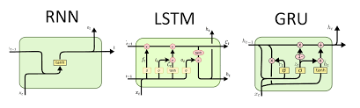
Methodology and Desired Outcome
Planned Network:
Long Short-Term Memory(LSTM) Recursive Neural Network (RNN)
Gated Recurrent Unit (GRU)
Desired Outcomes:
Increased Knowledge of time series predictions
Applicable knowledge to current research interests
High performing network for temporal predictions
https://www.google.com/imgres?imgurl=http%3A%2F%2Fdprogrammer.org%2Fwp-content%2Fuploads%2F2019%2F04%2FRNN-vs-LSTM-vs-GRU.png&imgrefurl=http%3A%2F%2Fdprogrammer.org%2Frnn-lstm-gru&tbnid=ZdAXCOHNPG2ueM&vet=12ahUKEwiZ4sqO35X9AhX6KkQIHSnJD1UQMygBegUIARDGAQ..i&docid=UeNxOPf6Kcn_6M&w=1849&h=557&q=GRU%20vs%20lstm&ved=2ahUKEwiZ4sqO35X9AhX6KkQIHSnJD1UQMygBegUIARDGAQ
Additional Outcome:
Apply LSTM,RNN and GRU to current GSL research

Slide 6
Thank You

